Slide 1
Charts

Slide 2
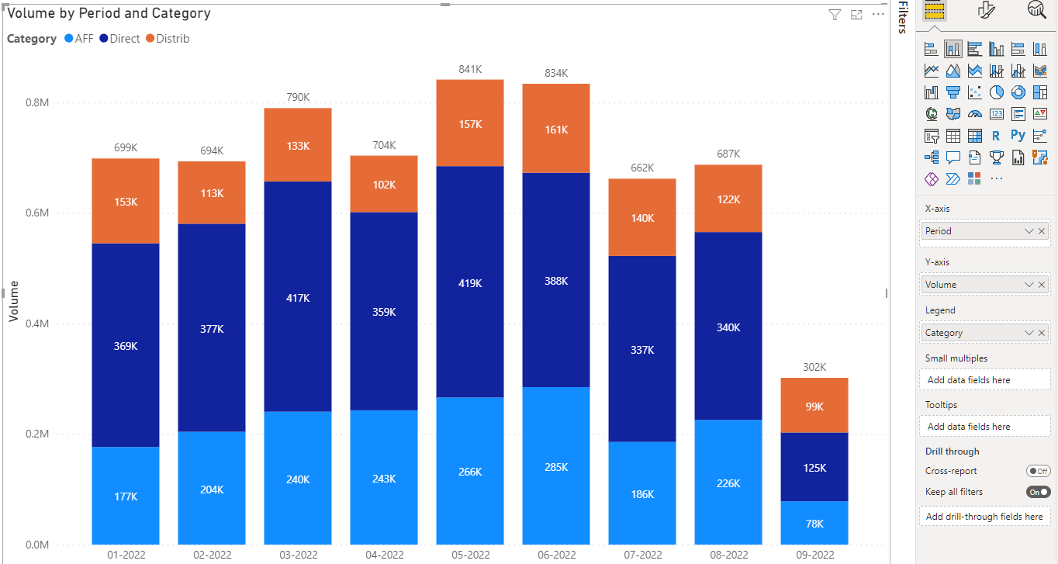
stacked column chart
Comparing Totals and Breakdown
A stacked column chart is a type of bar chart where multiple data series are stacked vertically in columns, one on top of the other. Each column represents a total, and the individual segments within the column show the contribution of each data series to that total.

Slide 3
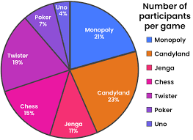
Pie chart
Showing Proportions: Pie charts are ideal for displaying the proportions of a whole, particularly when there are only a few categories.

Slide 4
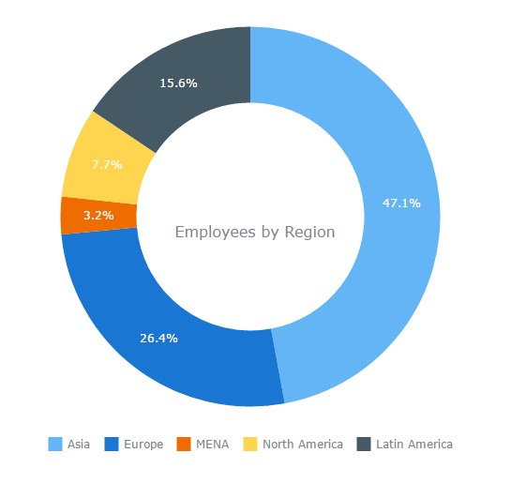
donut chart
A donut chart (or doughnut chart) is a variant of the pie chart that features a circular shape with a hole in the center. Like a pie chart, it is used to display the proportion of categories relative to a whole, but the hole in the center gives it a distinct appearance and can sometimes make the proportions easier to interpret.

Slide 5
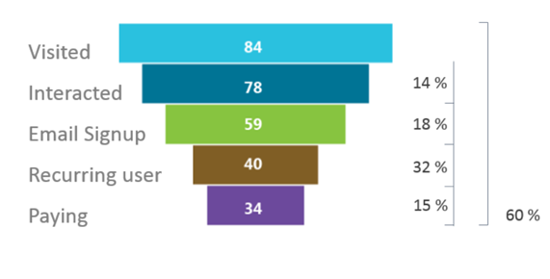
Funnel chart
A funnel chart is a type of chart that visually represents a process that starts with a large number of elements and gradually narrows down to a smaller number of elements as they progress through the stages. The chart is shaped like a funnel, with the widest part at the top and the narrowest part at the bottom, effectively illustrating the decreasing quantity as the process moves forward.

Slide 6
When to Use:
Conversion Processes: Funnel charts are particularly useful for visualizing conversion rates in processes like sales pipelines, lead generation, and marketing campaigns, where you want to track how many prospects or items progress from one stage to the next.
Customer Journey: They can be used to analyze customer journeys, showing how many users move from awareness to consideration, and eventually to purchase.
Highlighting Drop-Offs: The chart clearly shows where the largest drop-offs or losses occur in a process, helping to identify stages that may need improvement.

Slide 7
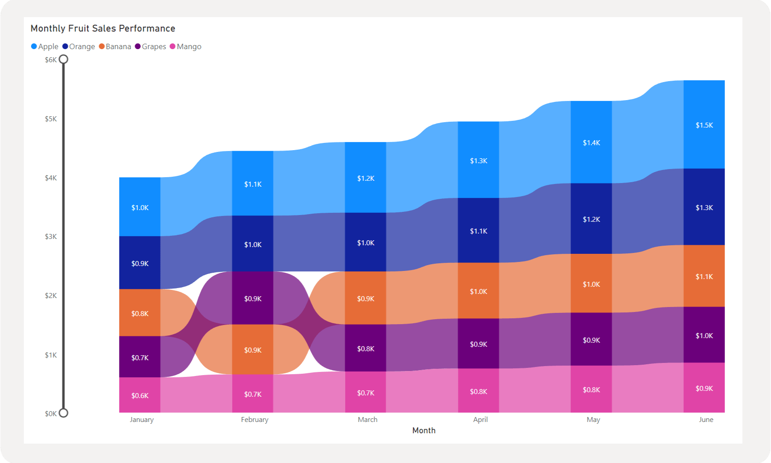
Ribbon chart
A ribbon chart is a type of data visualization used to show the rank and magnitude of values across different categories over time. It’s particularly useful for visualizing how rankings and values change over a series of periods or categories, with the "ribbons" connecting data points to emphasize movement or transition.
Legend: provide context and clarification for the data presented in charts and graphs

Slide 8
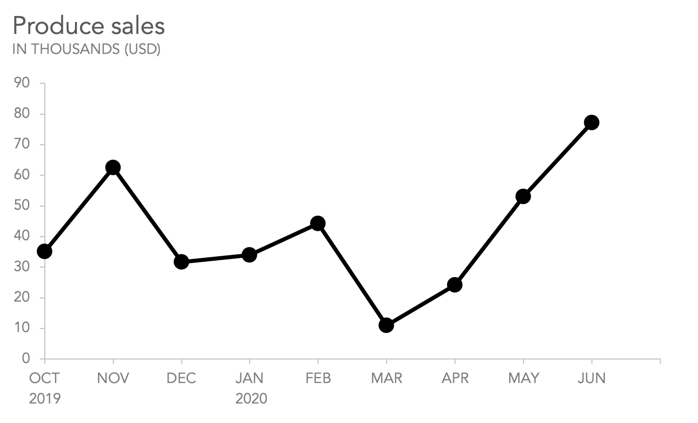
Line chart
A line chart, also known as a line graph or line plot, is a chart that displays data as a series of points connected by lines. The horizontal axis usually represents a continuous progression, like time, and the vertical axis shows values for a metric. Line charts are often used to show trends in data over time

Slide 9
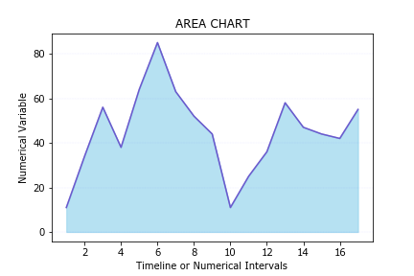
Area chart
An area chart is a visual representation of data that utilizes both lines and filled areas to convey information.

Slide 10
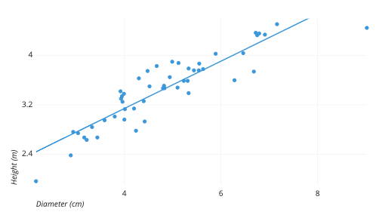
Scatter chart
A scatter chart, commonly referred to as a scatter plot, is a graphical representation used to explain the relationship between two continuous variables within a dataset.

Slide 11
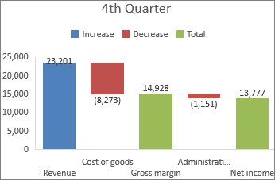
Waterfall chart
A waterfall chart shows a running total as values are added or subtracted. It's useful for understanding how an initial value (for example, net income) is affected by a series of positive and negative values.

Slide 12
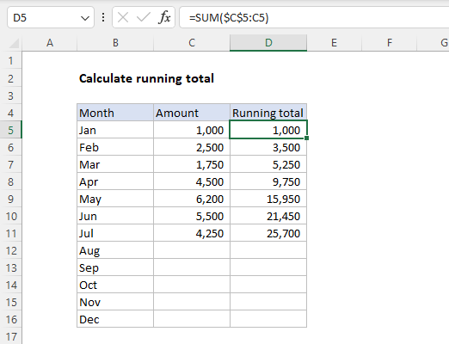

Slide 13
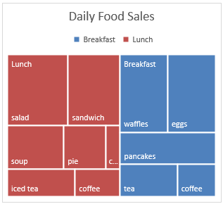
Treemap chart
A treemap chart provides a hierarchical view of your data and makes it easy to spot patterns

Slide 14
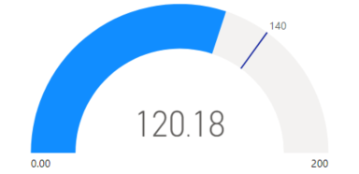
Gauge chart
gauge chart uses a circular arc to show how a single value progresses toward a goal

